Slide 1
No Time to Mine
Handover Presentation

Slide 2
Idea & Inspiration

Slide 3
Motivation & Constraints
Limited Timeframe (one Semester) -> limited Scope
Catching up the progress the others made in Wintersemester
Accessible for players of all levels
Coherent & Complete Experience

Slide 4
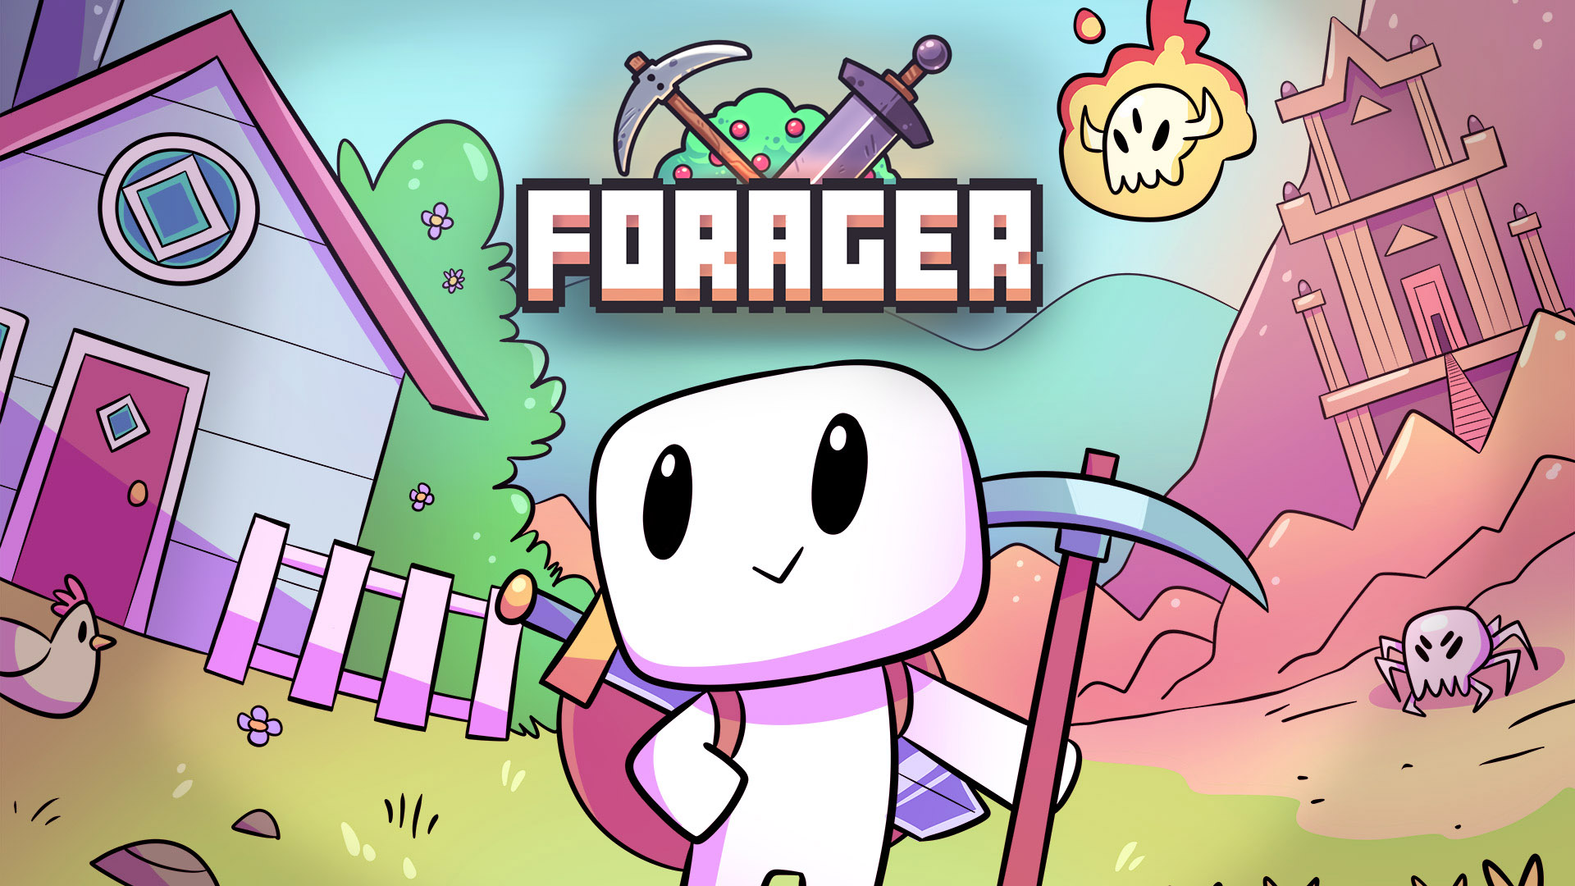
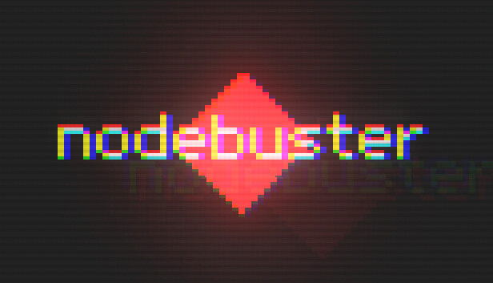
Inspiration
What games do i like, that are and realistic to implement given the time?

Slide 5
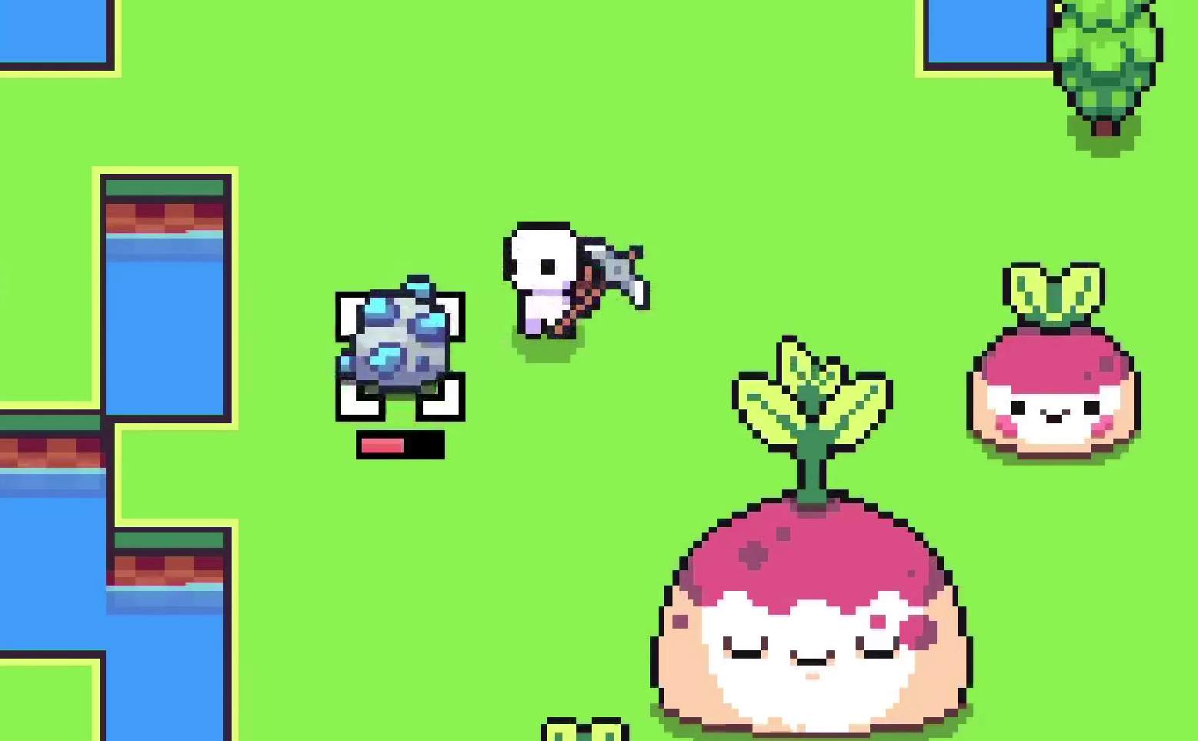
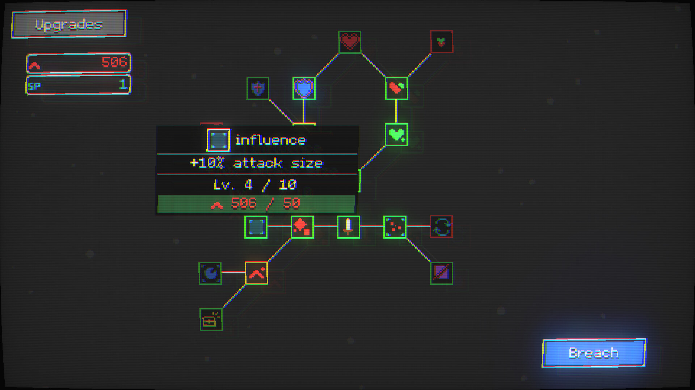
Idea
Combine the compelling elements of each game:
Forager:
Mining, resource collection
Simple cute artstyle
Nodebuster:
Skill tree
Limited life cycle
Similar characteristics:
Thrilling exponential growth
Upgrading the resource collection process

Slide 6
“finite life cycles with iteratively increasing progress”
Initial formulation of unique selling point
Core mechanics being: Mining, Resource Collection, Upgrading

Slide 7
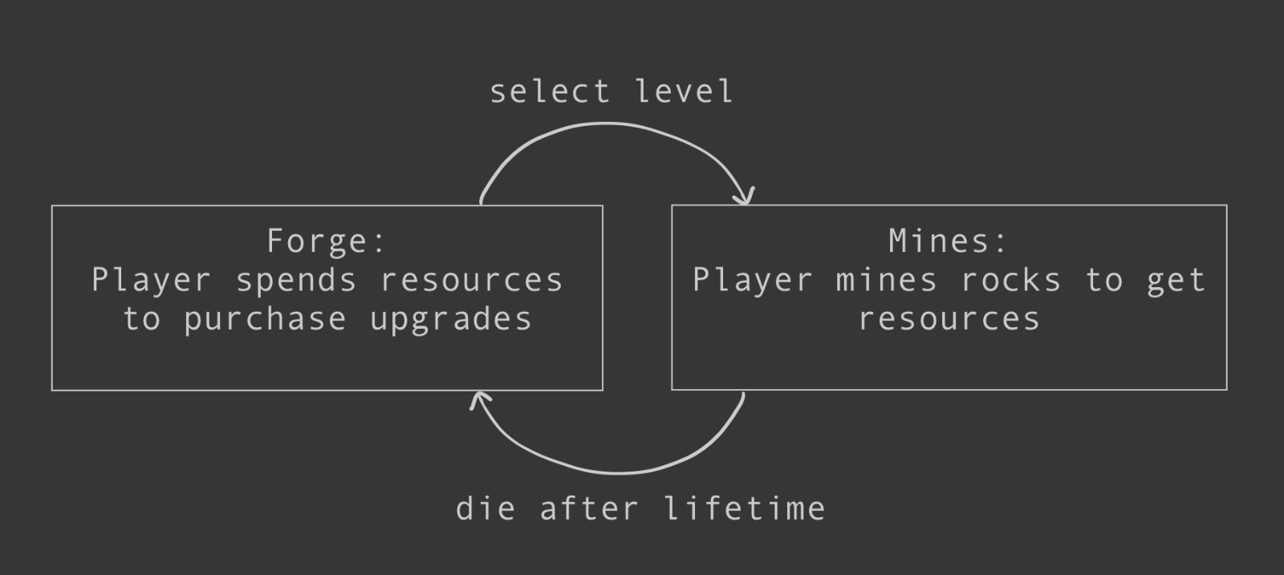
Identification of main game loop
First priority: Implementing and refine this loop

Slide 8
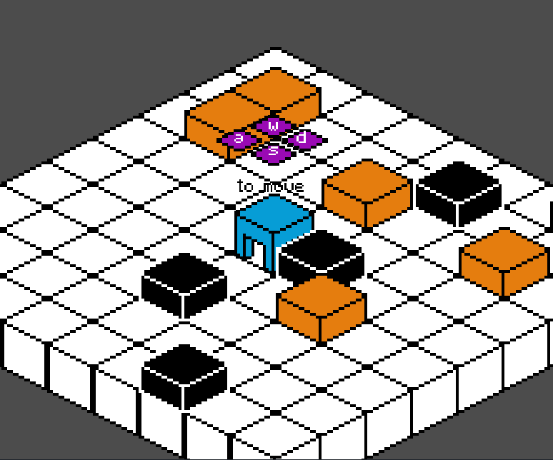
Implementation as Whitebox Environment
Early draft with placeholder art

Slide 9
Implementation
Architecture

Slide 10
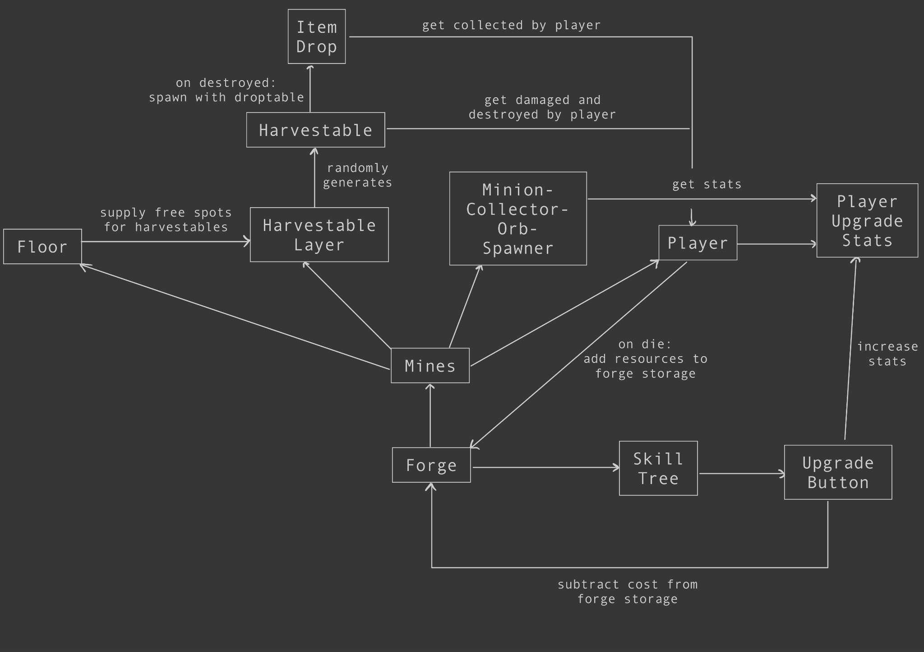
Main Loop

Slide 11
Important Classes
Player:
handles movement / controls
handles which harvestable is targeted
applies damage to harvestables
collects items, adds them to inventory / forge when dying
influences main loop control flow when dying
animates appearance
Forge:
handles savestate
populates loaded savestate
handles control flow of main loop
acts as monolithic singleton, most other classes are coupled to it
handles own appearance
UpgradeButton:
updates upgrade stats
handles visibility of children and info label
calculates and applies cost and stat increase
handles own appearance
Problem: Some classes do way to much, should be refactored

Slide 12
Things done well in implementation
Reusing code though composition:
ButtonAnimationWrapper
GridVectorToPositionConverter
GuiItemListDisplayer
Using utility scripts e.g. build, selfmade recolor pipeline:
RecolorMultiple
ImageRecolorer
Using godot resources, as more modular alternative to monolithic singleton:
TypePopulater
Using godot callables, e.g.:
TimeoutCallback
upgrade button strategy pattern
ScreenTranisiton

Slide 13
Visuals

Slide 14
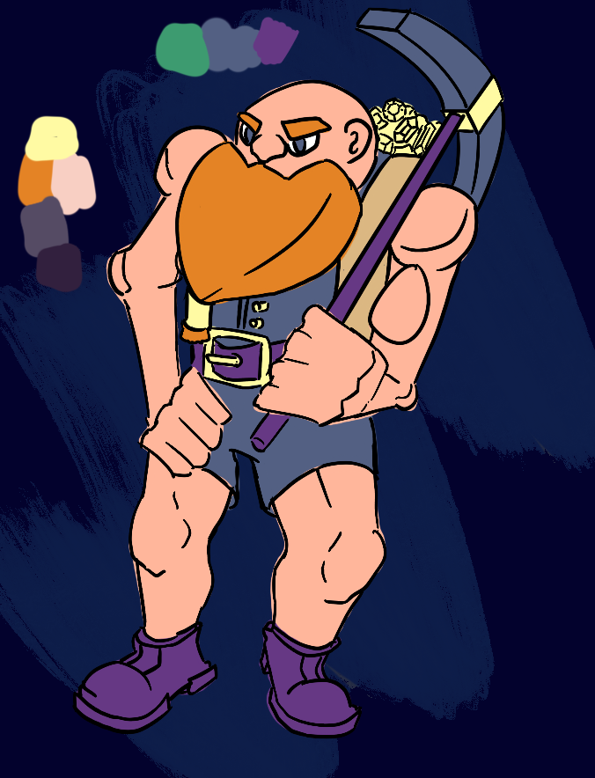
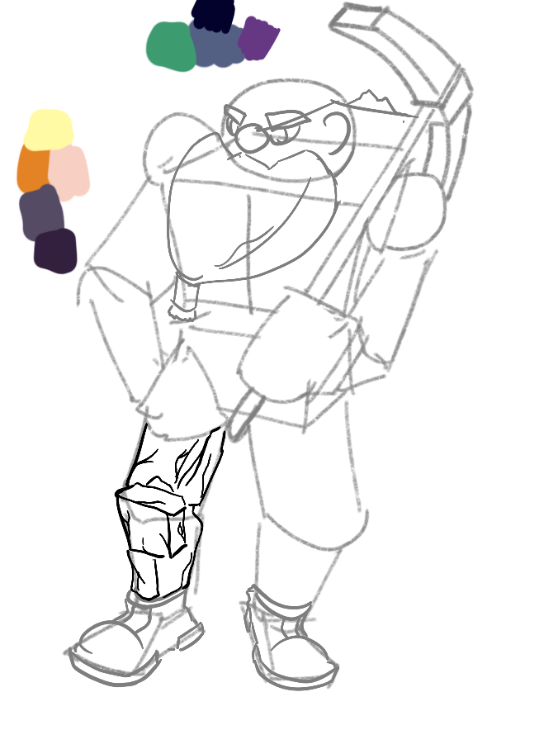
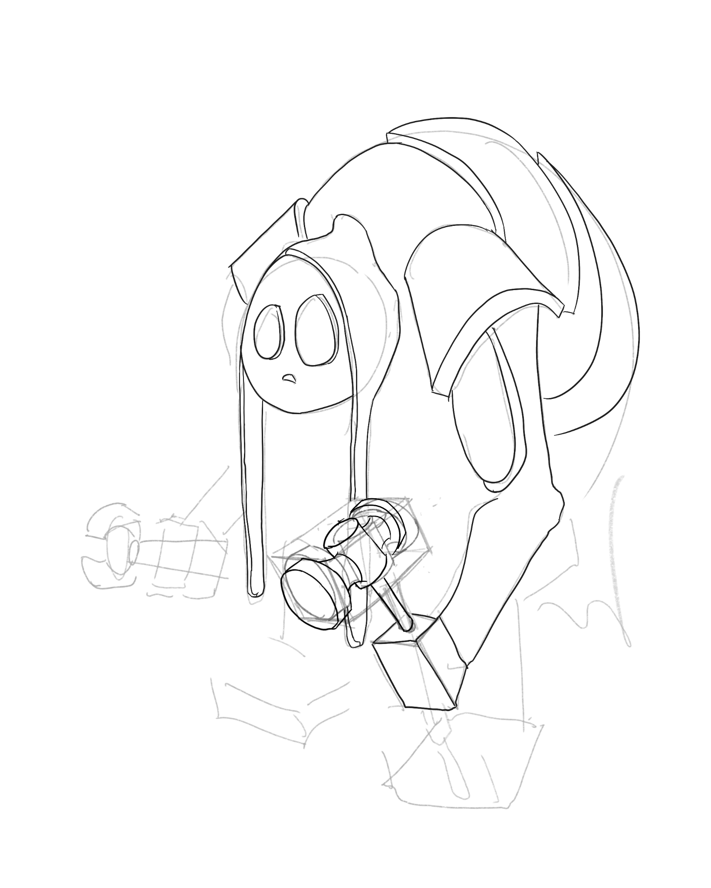
Working out the visuals: Setting
First concept art
Deciding character
should be rocky
Early draft of lore/backstory
Conclusion Setting mines, keep it simple (remember scope)

Slide 15
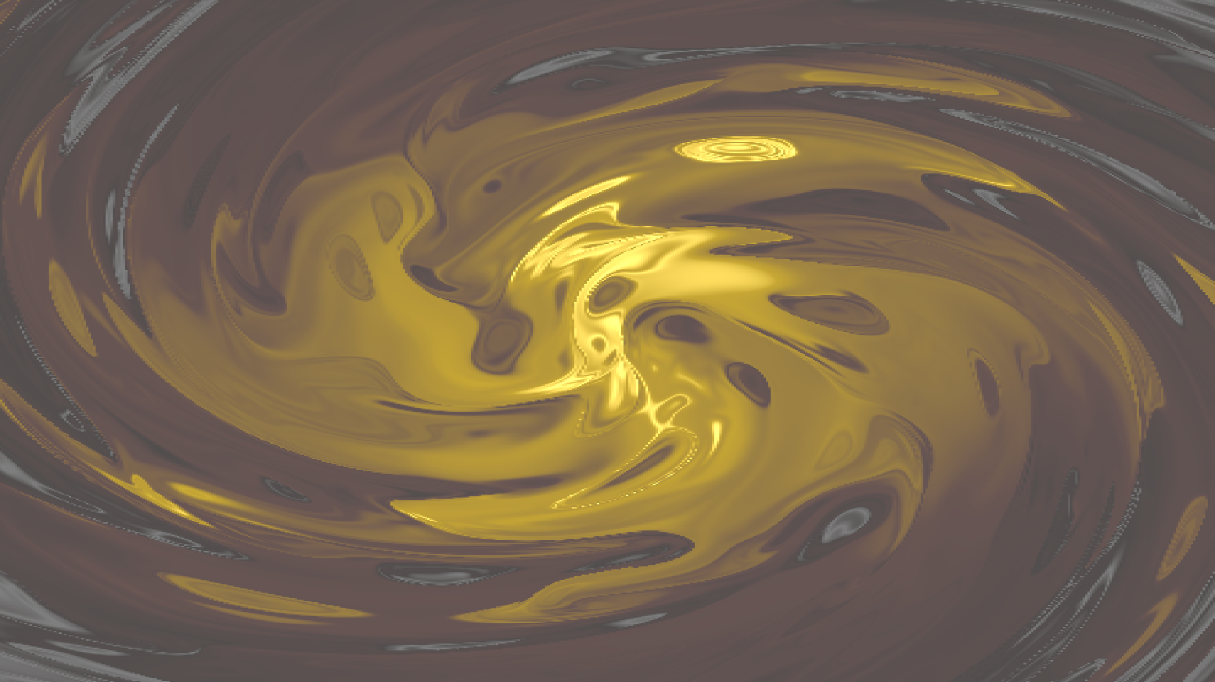






Working out the visuals: Sprites
Choosing a color palette from lospec:
First choice (Oil 6)
Went with rust gold 8, fits setting
Used balatro shader code for background, worked well with palette
First draft of sprites

Slide 16
Refining main loop

Slide 17

Improving audiovisual feedback
Self made sound effects with mic borrowed from hci and audacity
Animations, Particles, screenshake, camera lerp
Shader effects

Slide 18
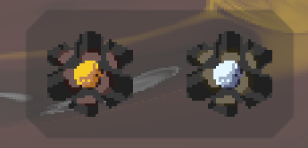
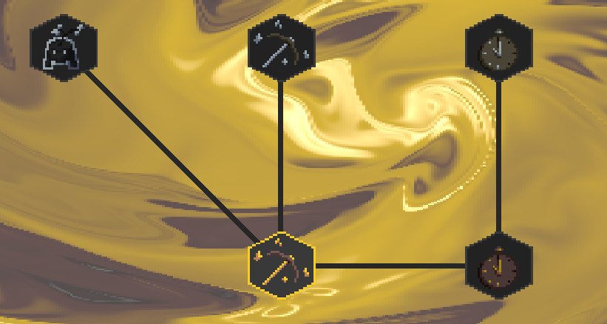
Adding a “goal” / progression
Level System
Add levels with different materials
Respective layers on skill tree for level
Each having same sprites recolored
Level unlocked by harvesting all rocks on a level
After clearing a level, you can replay it it being bigger -> thrilling exponential growth

Slide 19
Putting in content

Slide 20



Coming up with upgrades
Minion:
help player mining
Orb:
bouncing around
damaging rocks
Collector:
collect items
And respective upgrades for stats of them (damage, speed, ...)

Slide 21
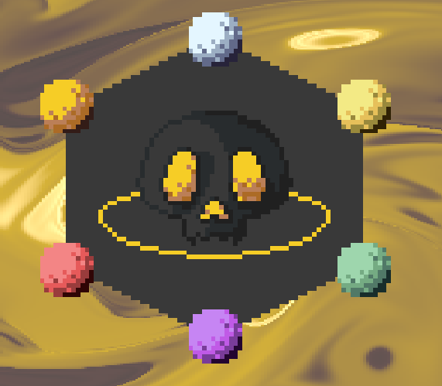
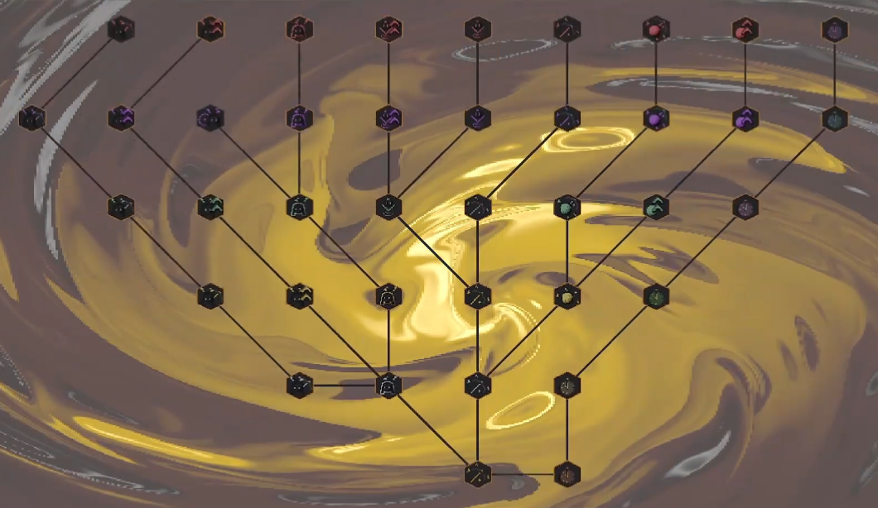
Defining content scope
Adding in a story, reusing assets
“Source” at start and end of game
Last level unlocked after 6 levels
Expanding the skilltree to 6 levels

Slide 22
Final Touches,
Preparing for
expo / release

Slide 23
Music by Drusba
Adding in music massively changed the vibe of the game
Did the music with a homie using samples from splice

Slide 24
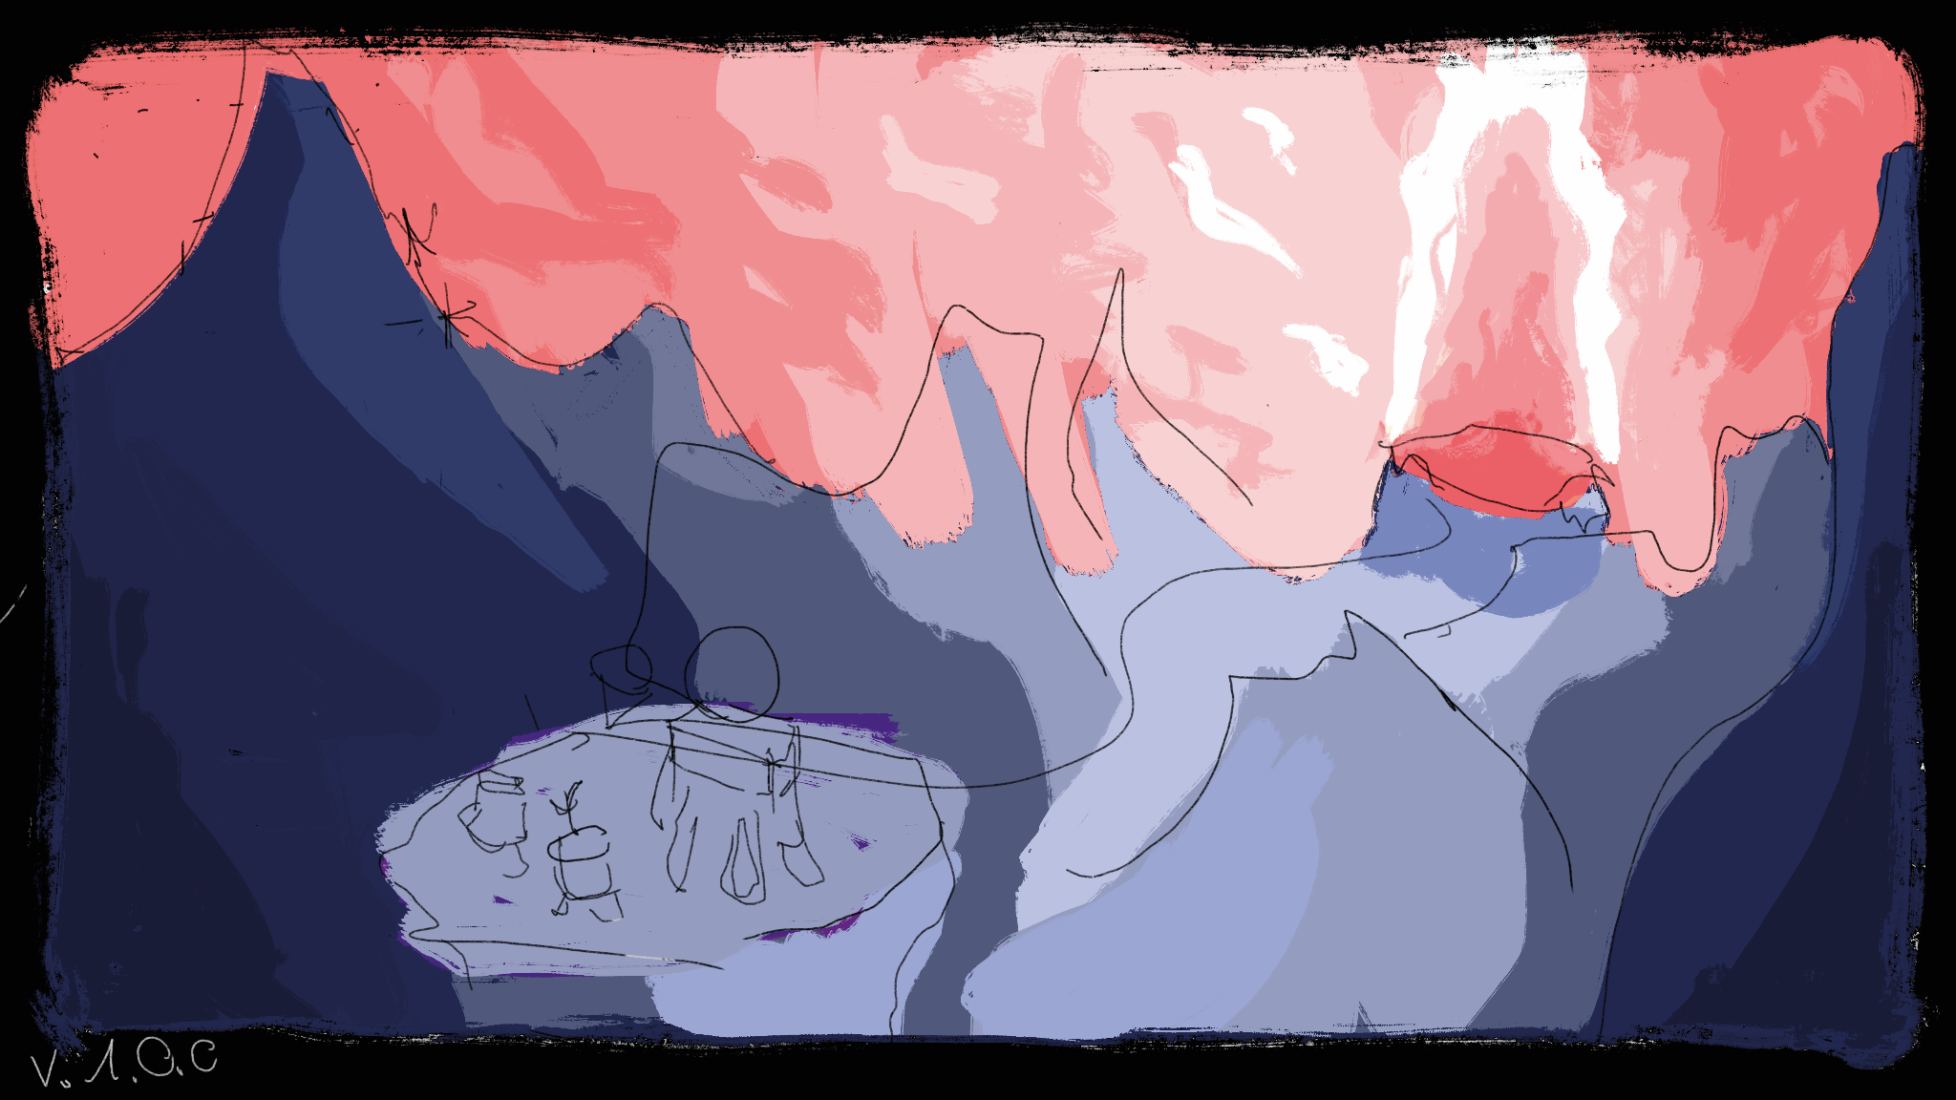
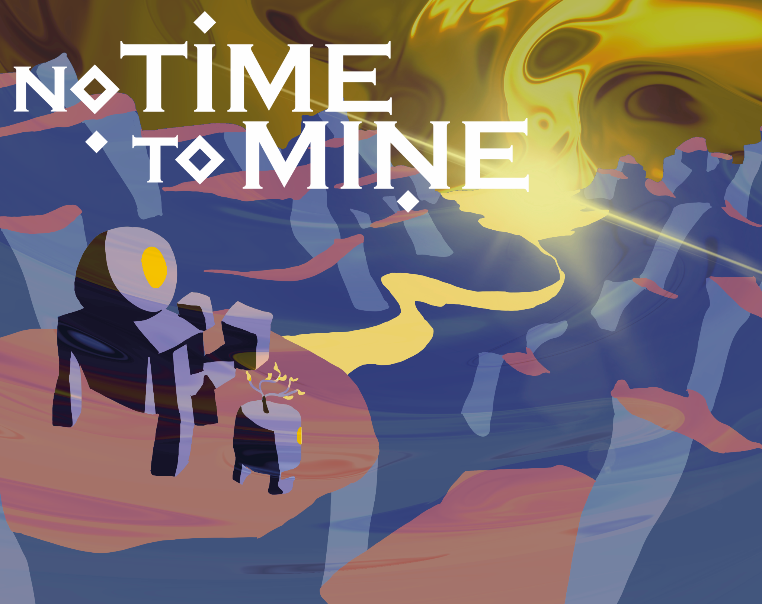
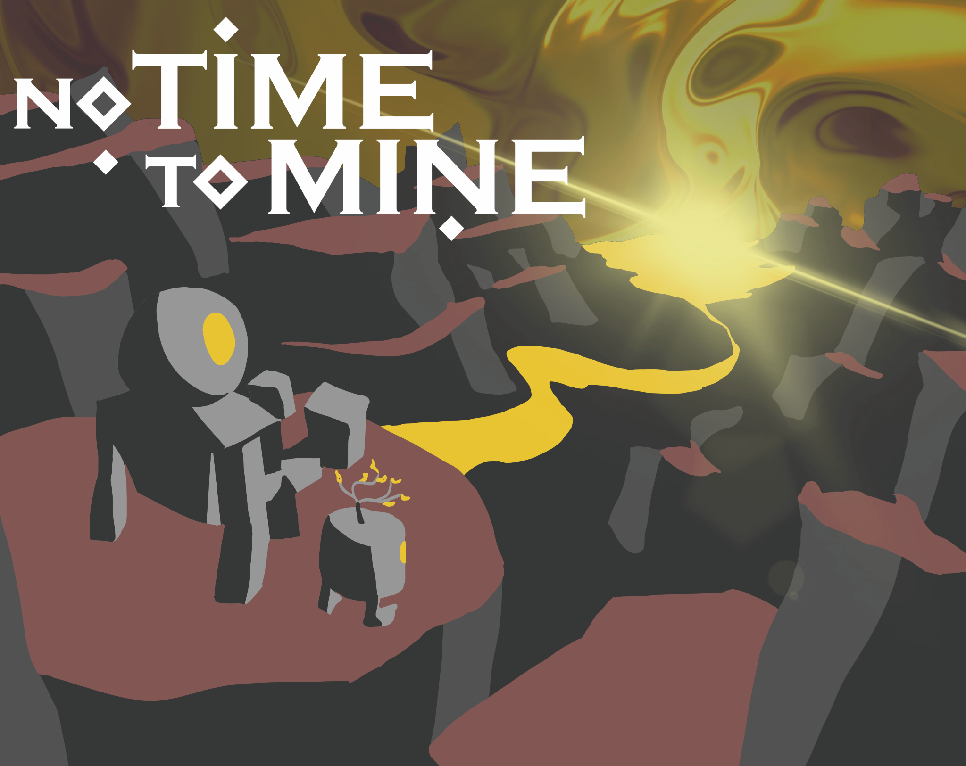
Titlescreen
First Draft (incomplete) work in progress final version

Slide 25
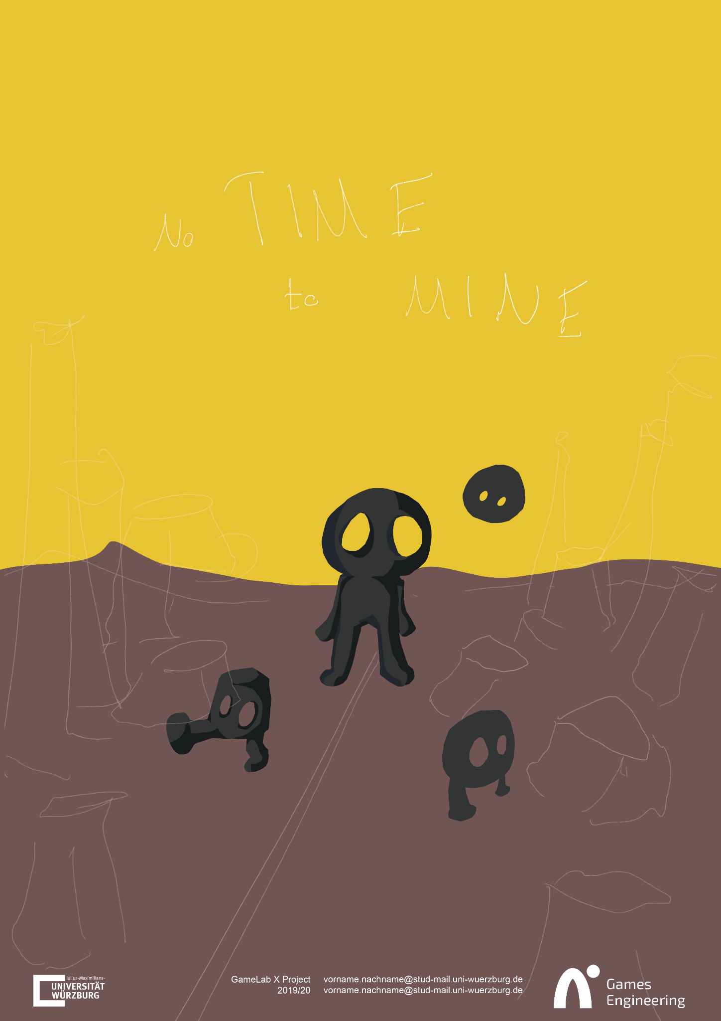
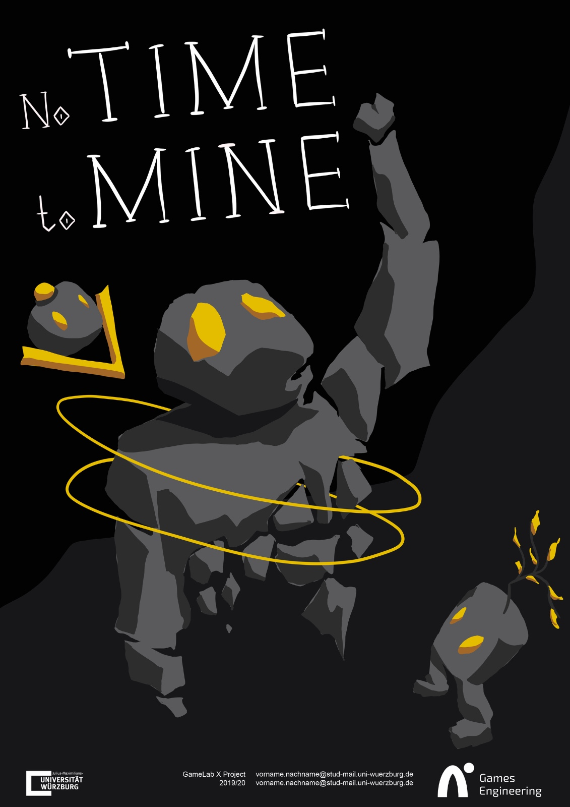
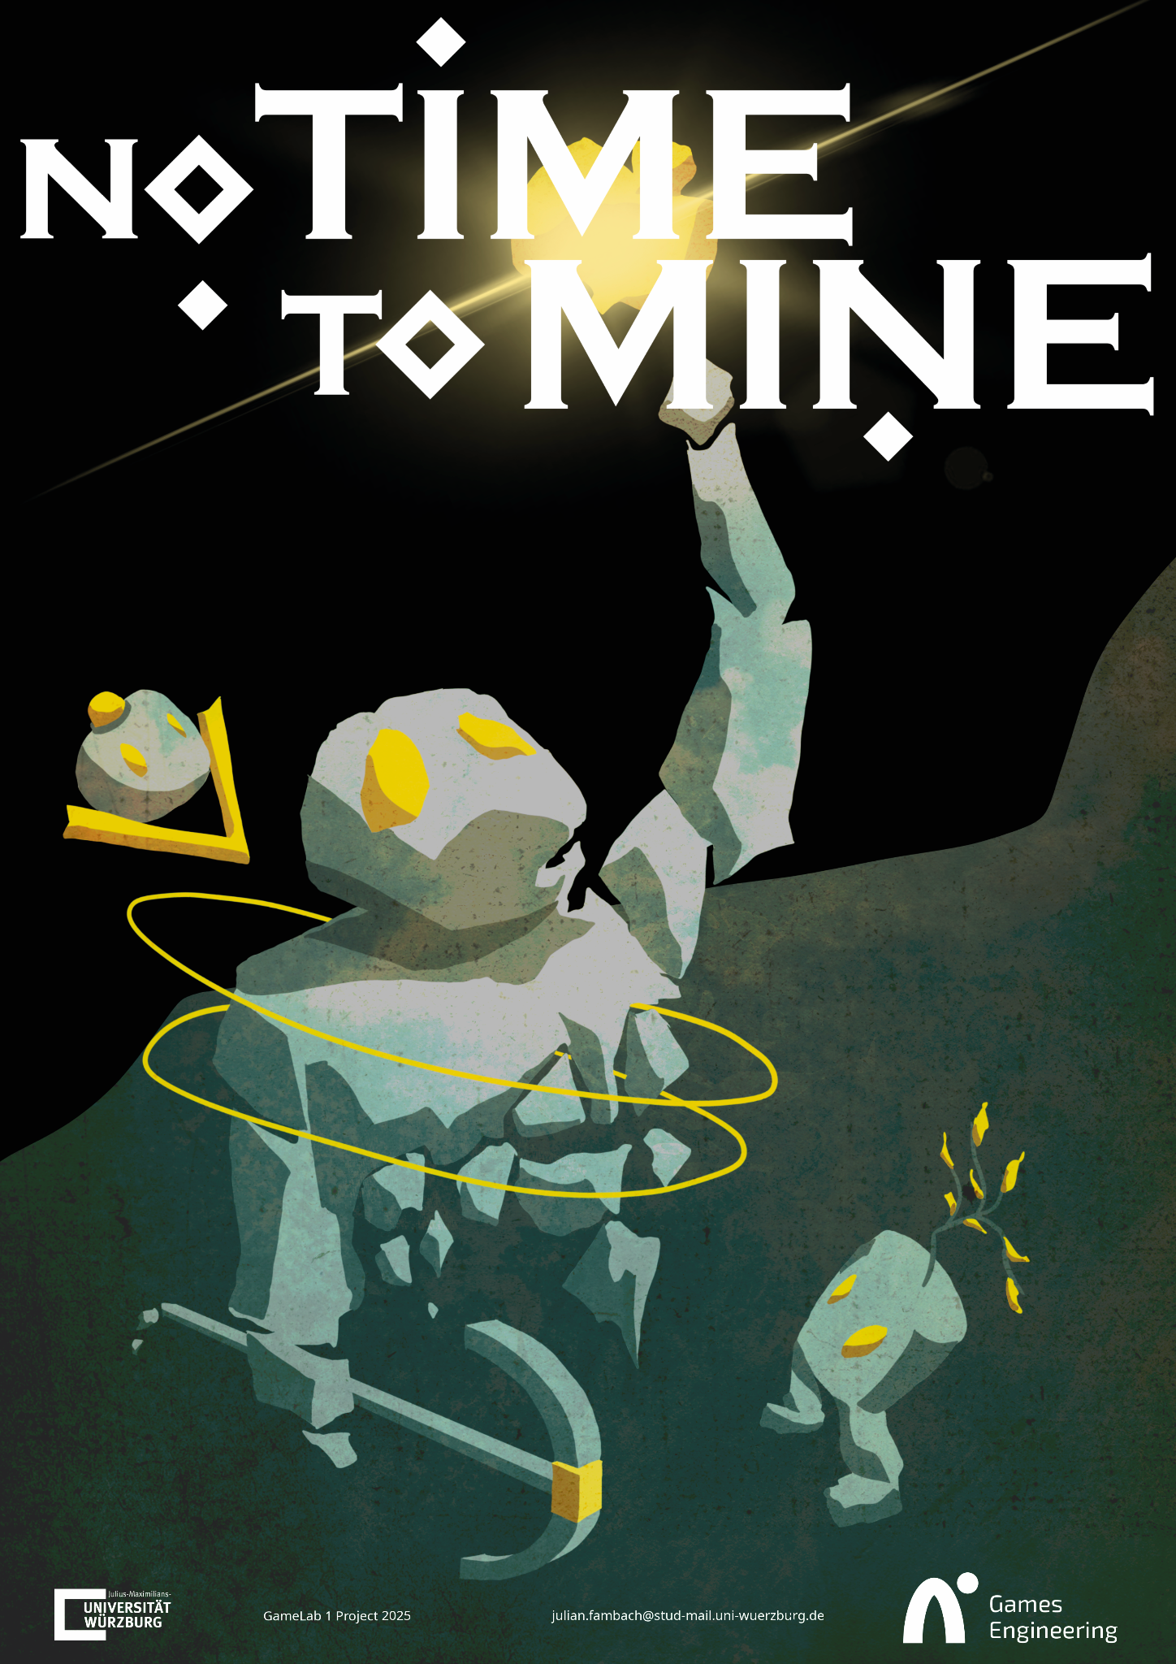
Poster
First draft (incomplete) Draft for presentation Final Version

Slide 26
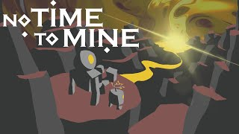
Trailer
https://youtu.be/rBGoRgpmopY?si=BEkYJN9gjaSZk-IW

Slide 27
Player feedback
Setup a playtester feedback survey and generated statistics (sample size 4)

Slide 28
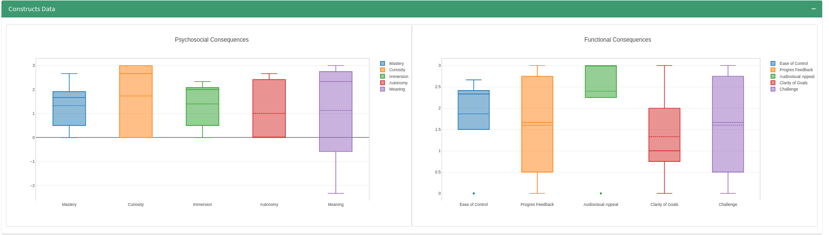
Player Feedback
Strengths: audiovisual appeal, curiosity, accessibility(ease of control)
Weakness: meaning, clarity of goal

Slide 29
Thanks!
Find this and my other projects at:
hiqqup.itch.io

